Slide 1

Aphasia-friendly video abstracts
PowerPoint Guide
See the accompanying written guide

Slide 2
General design advice

Slide 3
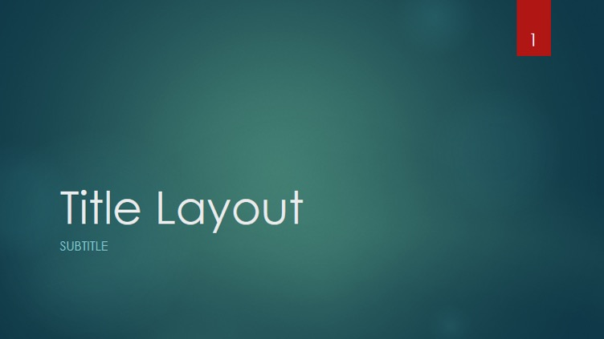


Avoid PowerPoint templates – a solid colour background is usually best
✓

Slide 4
Include plenty of blank space to improve readability. (Brennan et al., 2005; Rose et al., 2011a)
This includes margins and between objects.

Slide 5
You’ll notice this text nearer the edge of the slide looks a bit ‘busy’ or rushed.
Having text or visual objects too close to one another also looks bad.

Slide 6

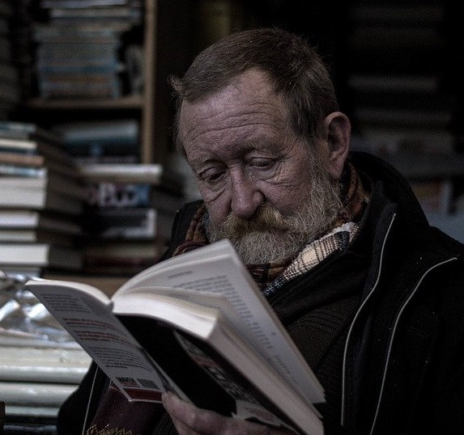

Don’t use too many pictures as they become redundant or distracting. (An example of too many here – one would do, if it is the right image) (Parr, Wimbourne, Hewitt & Pound, 2008)
Aphasia can make reading hard.

Slide 7

Transparency – removing backgrounds
Link to video

Slide 8
Transitions and fades (less is more)
Use sparingly as these tend to be distracting and if overused can detract from the intended message

Slide 9
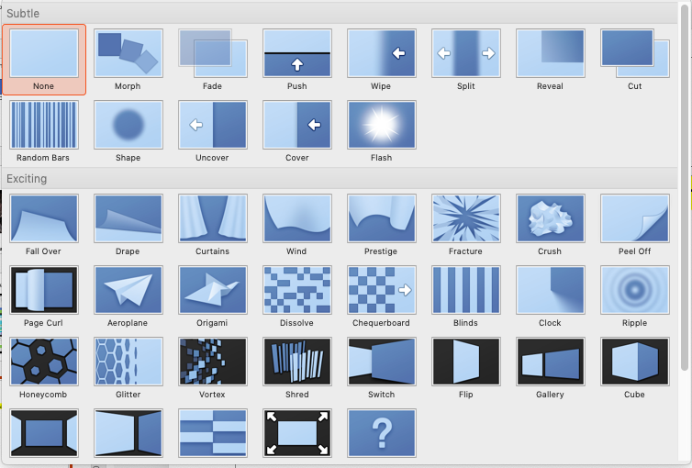
✓ Simple and non-distracting
Avoid most other transitions as they typically don’t add information to your message (and are therefore a distraction!)

Slide 10
Animation tricks

Slide 11
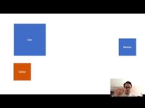
Morph transition – “cheater’s animation”
Link to video

Slide 12
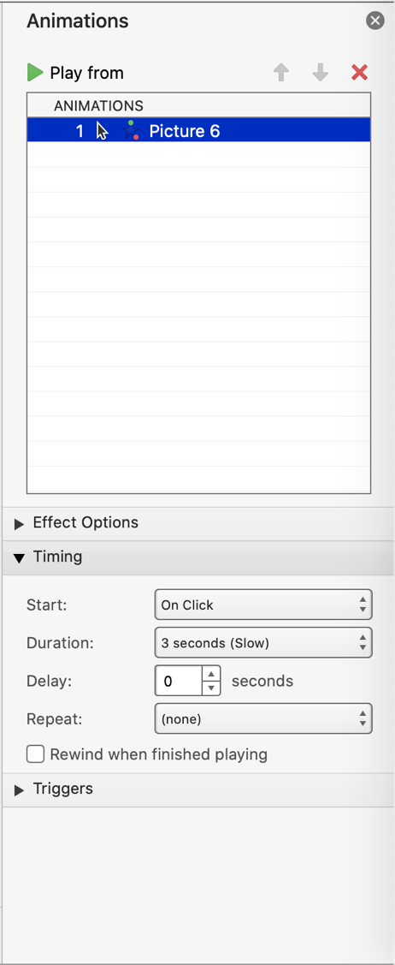
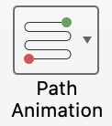

Path animation
Use path animation to move objects and images around the slide
Change animation settings in the Animation Pane

Slide 13

Grow/shrink
Animations can also be used to change the size of images and objects.

Slide 14
Using screening objects
This chart is “screened” by a white rectangle. The rectangle has an exit effect that wipes it from view, revealing the chart beneath.
(Run slideshow to view in action)
Animations like this make for more dynamic videos.

Slide 15
Recording

Slide 16

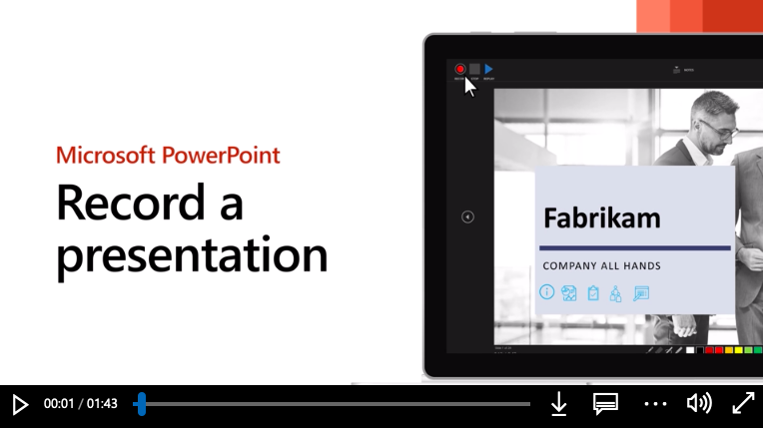
This icon is a sound file. Hover over it to reveal audio controls. The icon is sitting off the canvas so it won’t appear on the final video.
Click here for a narration tutorial from Microsoft
You could insert an audio file of the narration recorded outside PowerPoint. Select a sound file from the Insert menu item.

Slide 17
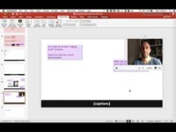
You might like to add a “talking head” narration.
Watch the video for a quick demonstration.
Make sure you leave a space on each slide for the video element. You don’t want your text or graphics covered up by your video.
Search online:
“picture in picture video editing”
Link to video: https://cloudstor.aarnet.edu.au/plus/s/GcIctvWutjoBc5P
*Availability of the video record feature depends on your version of Powerpoint

Slide 18
Sample images

Slide 19
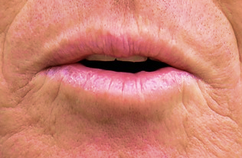


Here are some sample images relevant to aphasia – public domain

Slide 20







Microsoft icons
Icons from Microsoft Office are free to use (Public domain). However, icons are less preferred by people with aphasia than photos or illustrations so use where you have no other options.

Slide 21
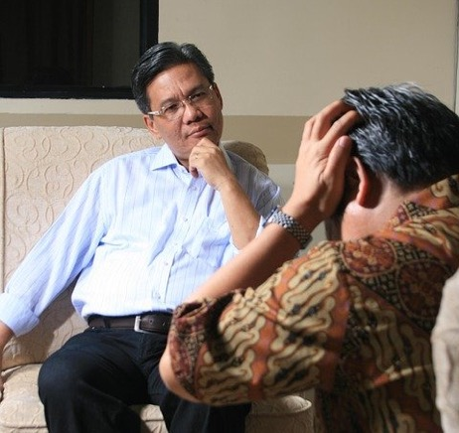


These images are from pixabay.com and are public domain

Slide 22
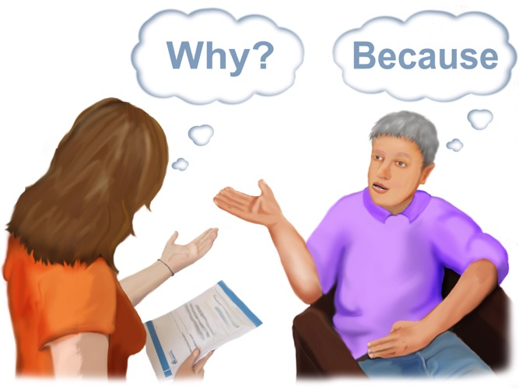
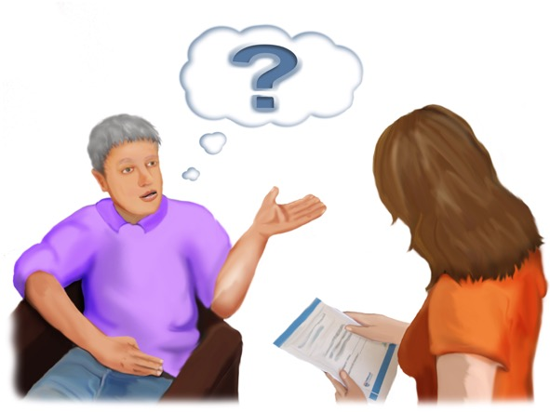

http://speakeasy-aphasia.org.uk/
http://speakeasy-aphasia.org.uk/
These stroke and research images are free to use but you must include a link to the Speakeasy website as attribution – see example attributions on this slide.
http://speakeasy-aphasia.org.uk/
http://speakeasy-aphasia.org.uk/

Slide 23




http://speakeasy-aphasia.org.uk/
http://speakeasy-aphasia.org.uk/
http://speakeasy-aphasia.org.uk/
http://speakeasy-aphasia.org.uk/

Slide 24
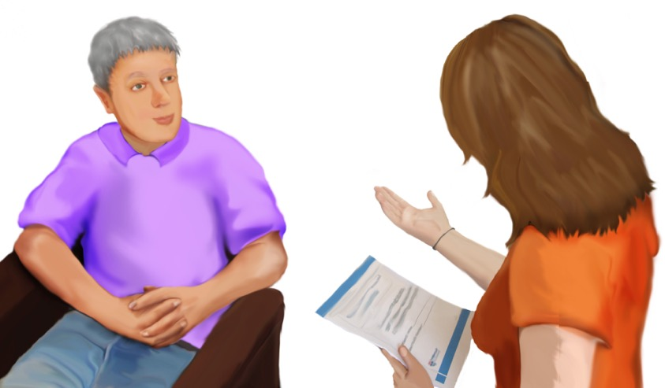
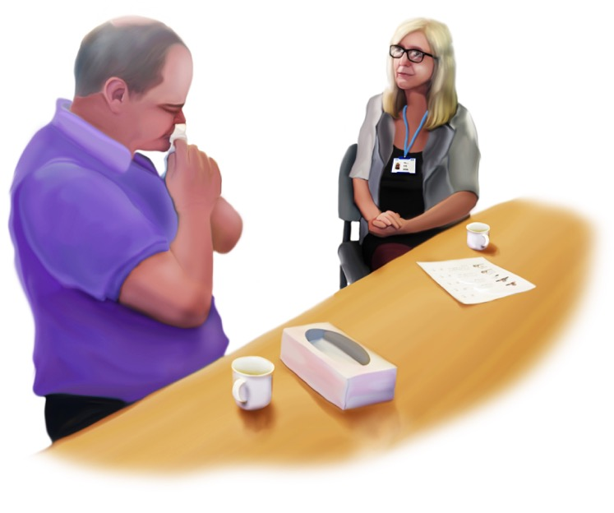

http://speakeasy-aphasia.org.uk/
http://speakeasy-aphasia.org.uk/
http://speakeasy-aphasia.org.uk/

Slide 25

